Slide 1
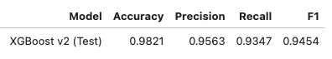
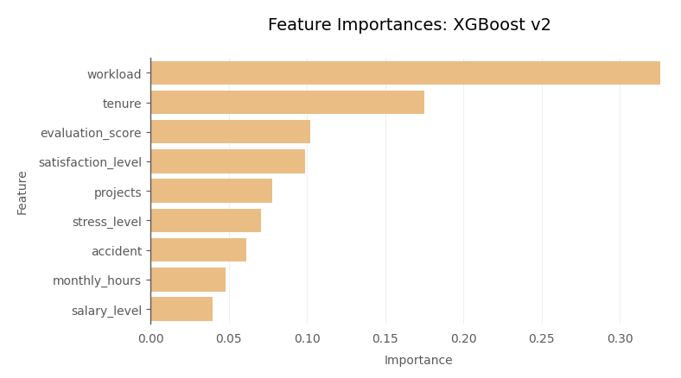
Employee Retention Project
Executive summary for Salifort Motors senior leadership by the data team
Salifort Motors senior leadership has asked the data team to analyze the survey data collected by the HR department and provide recommendations for how to increase employee retention. A successful outcome will help the company to increase retention and job satisfaction for current employees, and save money and time in recruiting and training new employees.
Salifort Motors currently has a high employee turnover rate (16.6%), suggesting that a large proportion of its employees may be dissatisfied with their jobs. This high turnover rate not only hinders the company’s efforts to establish a thriving work culture but also poses potential adverse effects on employee productivity and well-being. Further, it is costly in a financial sense.
Analyze the survey data with visualizations and build various predictive machine learning models to help the company to increase employee retention. The analysis revealed the main factors influencing employee departure, and the highest performing model exhibited an exceptional accuracy in identifying employees likely to leave the company.
The analysis identified high workloads, limited career advancement opportunities, and burnout among high performers as the three main factors behind employees leaving the company.
In the model comparison, XGBoost v2 outperformed others, achieving an outstanding recall rate of 93.5% on the test data in identifying leaving employees.
Workload (engineered), tenure, evaluation_score, and satisfaction_level were the four most important features for the model. Surprisingly, promoted and overtime (engineered) were consistently among the least important features for all models.
Recommendations. (1) Distribute projects equitably to reduce excessive workloads. (2) Implement structured promotion plans to identify and support high performers. (3) Foster a culture of employee well-being and appreciation through flexible work arrangements, stress management programs, and meaningful recognition. (4) Deploy the XGBoost v2 model to identify employees at risk of leaving and implement preventative measures.
Improvements. The performance of the XGBoost v2 model could be potentially improved by (1) collecting more data, such as office location in future surveys and (2) optimizing the model’s decision threshold to attain the highest possible recall score.

